Slide 1
SVD CAN BUS VISUALIZER
GABRIEL STROE

Slide 2
THE ENVIRONMENT
CAN BUS
Sends HTTP
Client PC on a web browser
Micro Board
Web Server

Slide 3
THE WEB UI
WEB UI Features
Get Real-time updates
Filter different CAN messages
Report BUS Errors
Have an SVD HMI System

Slide 4
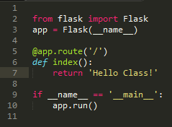
Building the Web Server application
Web server was created with python
Multi Platform
Supposedly easy to learn
Flask
Flask is a lightweight web API that allows the programmer to make quick and create endless amounts of URLs.

Slide 5
Building the Web Server application
So the very first think I tried create was a Web Server that could read a file and pass it to the html client.
To do this we need some sort of format that our Web page could actually make sense of the data.
Knowing that we are going to be using D3.js for the HTML client, the best route was to use the JSON format. (Java Script Object Notation)
(Also works well with Flask)

Slide 6
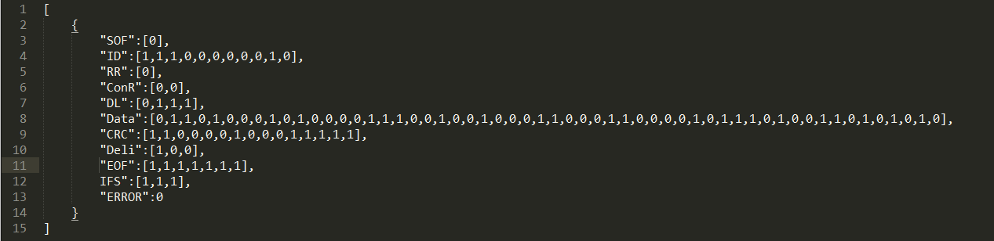
Notes this as an array
A single attribute
Attribute data
(can be of any type)
Like in an array, the next attribute is separated by a comma
Attribute Name
Marks this as ONE object

Slide 7
Time to send the message
When ever someone puts in a address of a website a HTTP Get request is done for that file. (The website is stored as a file on the server)
What flask does is take these file request and reroutes it to a function.
This allows me to perform any necessary calculations before I return anything.
It can even use part of the URL as a variable.

Slide 8

This is the route
This is the function
Return the date requested

Slide 9
Having D3 read that message
So before we draw any pretty pictures, we need to pull the data.
D3 as an integrated AJAX (Asynchronous JavaScript And XML) calls and can directly load a JSON File.
Also a large advantage of this is that we do not need to reload the entire page, just the parts that is affected by the java script will be reloaded.

Slide 10
Load a JSON
The JSON data is in this variable
Run what ever is you harts content
Load from this file on the web server

Slide 11
Now Draw!
This is the somewhat tedious part
D3 objects have 2 major parts: The DOM Elements and any Associated data
So we need to bind data to the DOM elements
Don’t want to hand create all elements.
Best method is to use the Enter Selection.

Slide 12
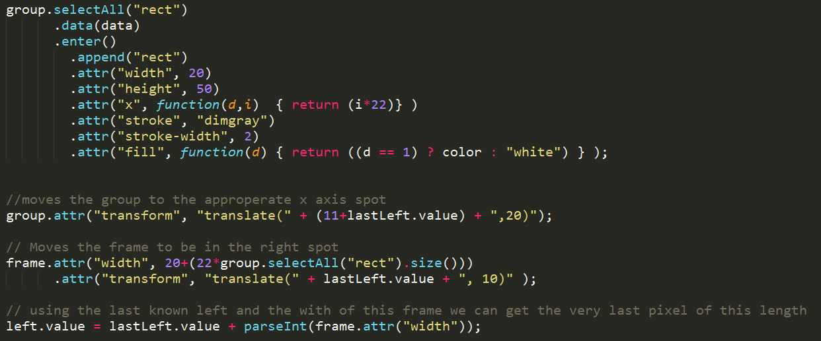
This is a predefined group of objects, Currently it is empty.
Get all rectangles
Bind data to the group
Enter creates a new object for every data element (Looks at data as an array)
Add a Rect
Move it in the ex direction based on data number (i)
Fill based on data value.

Slide 13
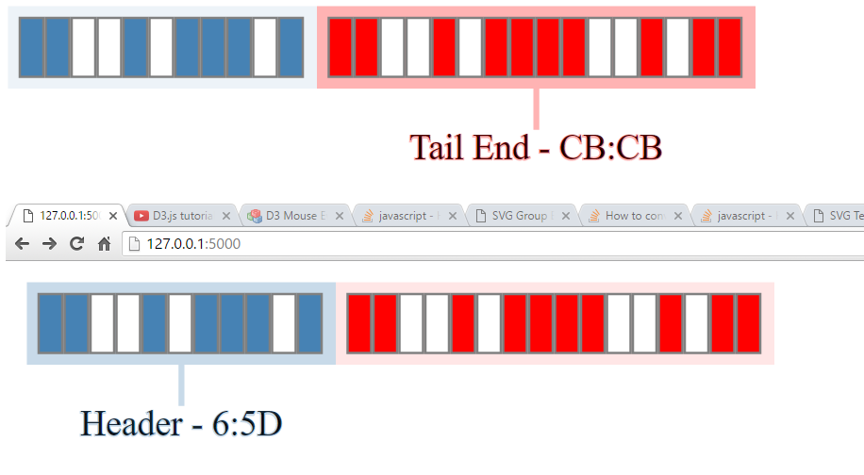

Slide 14


Pie Graphs
Similar to how the Bars where down but they use a Layout and a scale.

Slide 15
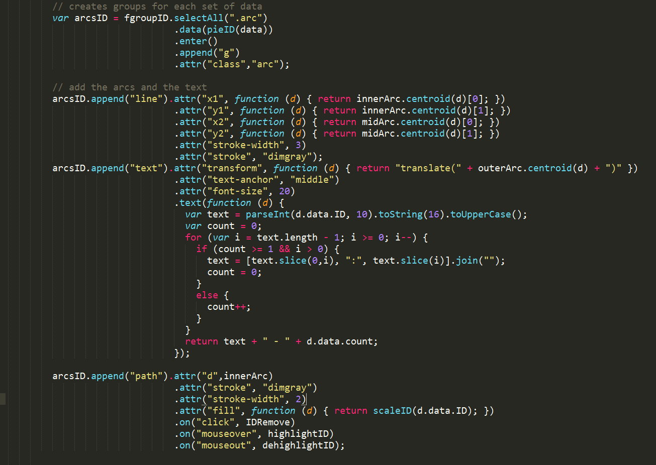

Slide 16
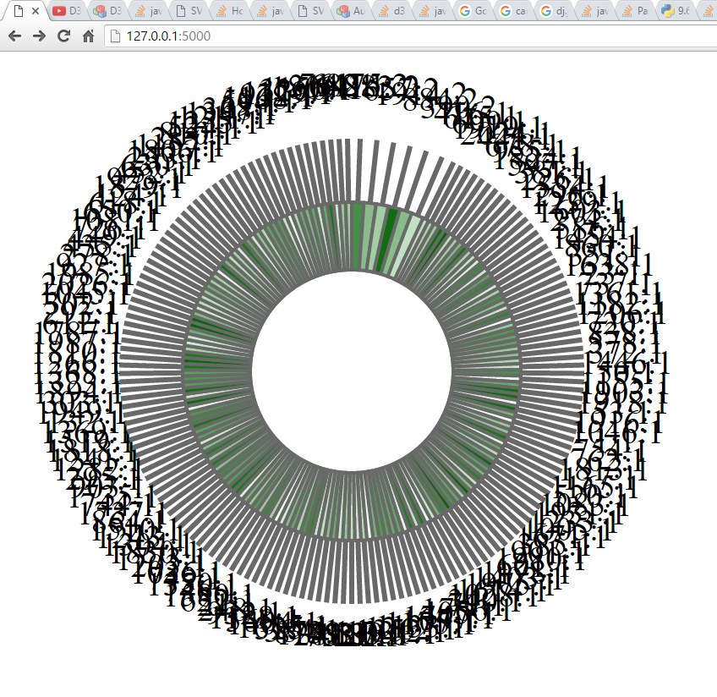

Slide 17
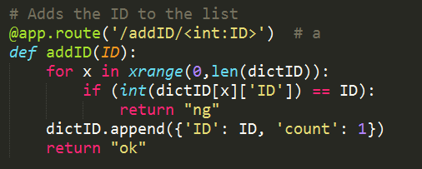
Adding data to the pie chars from other data
The <> holds a variable that can be passed to the function
The variable
Add data to array if not already there
Returns a value
(doesn’t currently do that, mostly for debugging)

Slide 18
Troubles
There where lots….
First was actually figuring out how to generate this data.
Made a Random number gen that formates data into a Can message
Figuring out How to place the groups of the boxes was really difficult.
Assigning values in D3 easy, returning them not always so.
Placement was also done based on pixel locations
The flask file was very difficult to pass the data correctly
No debugger =(
And really unfamiliar with python style languages…

Slide 19
Troubles
Also issues with data not erasing on the transitions
Had to get rid of a lot of transitions
Resorted to recreated the Data objects every call as a temporary fix.
Making sure that messages were passed correctly is difficult with two different applications
Also conflicting data types broke the python script a lot.

Slide 20
The next Steps
This project now needs to be expanded in two different ways:
The can bus analyses needs to be build on the rasberry pie to read data and store it for the webserver to display.
Will need a hardware device to read the message
and some software to format and store properly
The next is to actually expand the front end and show the data in a unique and SVD way
Data should be stored in graphs then expanded to the other view.
Much more filters and functions
Design overhaul

